Slide 1
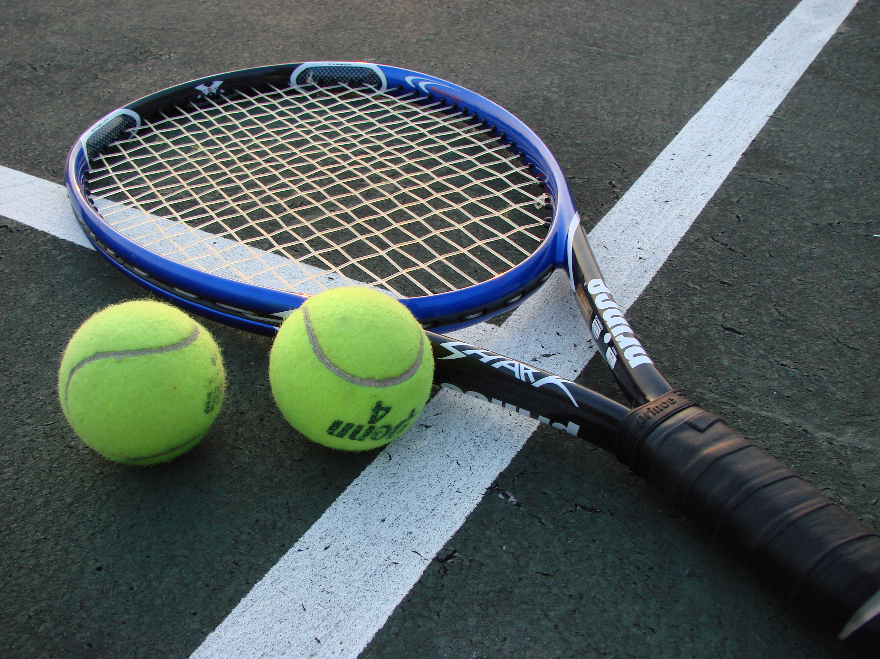
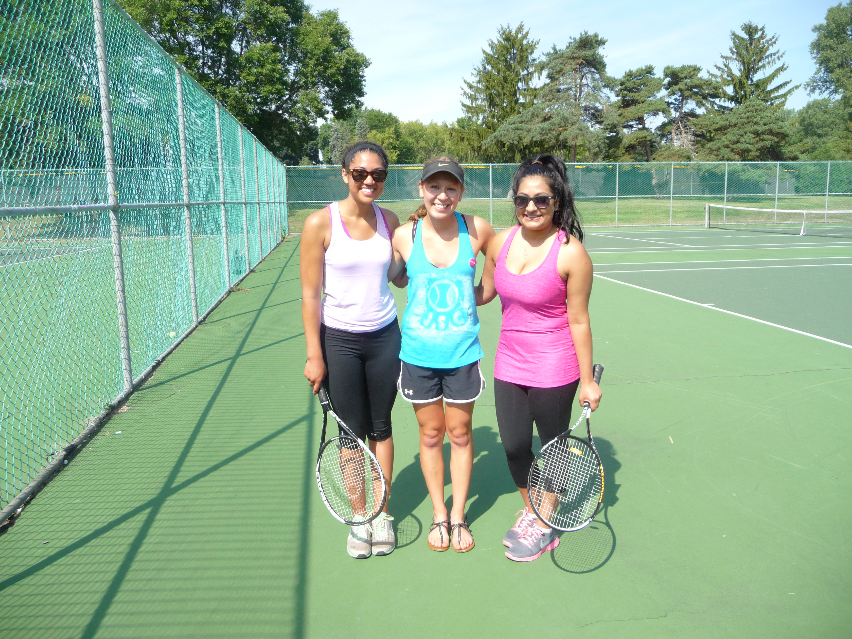
Weekend One-Day Adult Tennis Clinics
Play Tennis and Move with the Middleton Jaycees!
The Middleton Jaycees are celebrating Physical Wellness Month with a tennis clinic open to any adults who want to learn and play TENNIS!
Choose from two 1.5-hour beginner and advanced beginner programs.
Saturday, April 25th: 1:00-2:30pm
& 3:00-4:30pm
Sunday, April 26th 1:00-2:30pm
& 3:00-4:30pm
At: Lakeview Park, 6300 Mendota Ave, Middleton
$15 per session or sign-up for BOTH days for only $25!
Register at: www.middletonjaycees.org
Proceeds supporting the Kelly Johnson Foundation & JCI Middleton

